Slide 1
Introduction to RNA-seq
Justin Gibbons, PhD

Slide 2
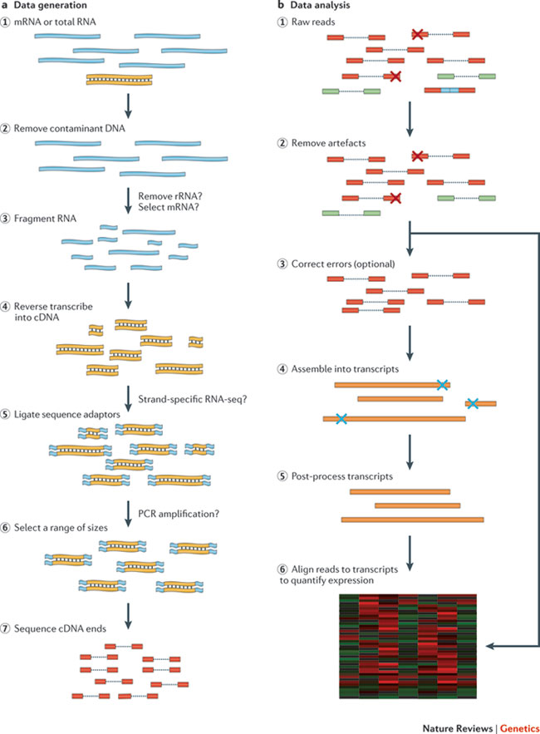
RNASeq
Data Generation
Data Analysis
A major breakthrough (replaced microarrays) in the late 00’s and has been widely used since
Measures the average expression level for each gene across a large population of input cells
Useful for comparative transcriptomics, e.g. samples of the same tissue from different species
Useful for quantifying expression signatures from ensembles, e.g. in disease studies
Martin, J. A. & Wang, Z. Next-generation transcriptome assembly. Nature Rev. Genet. 12, 671–682 (2011).
https://genomebiology.biomedcentral.com/articles/10.1186/s13059-016-0881-8

Slide 3
Types of RNA-seq

Slide 4
Experimental design: Number of replicates
Number of replicates more important than read depth or read length [93]
Factors dictating sample size:
Effect size
Within-group variation
Acceptable false-positive and false-negative rates
Maximum sample size
Tools for calculating sample size:
Scotty—Power Analysis for RNA Seq Experiments
Website
Uses a pilot run or publicly available to perform power calculations
Allows modeling of how much additional power costs ($$$)
PROPER—R package for RNA-seq power calculations
Creates simulations of RNA-seq data from provided data
Creates plots demonstrating how sample size and sequencing depth affect true discovery rate and false discovery rate

Slide 5
Experimental design: Sequencing depth
Notes:
Typical experimental read depth range is 10-30 million reads per sample (Range for eukaryotic organisms)

Slide 6
First analysis step: Quality control

Slide 7
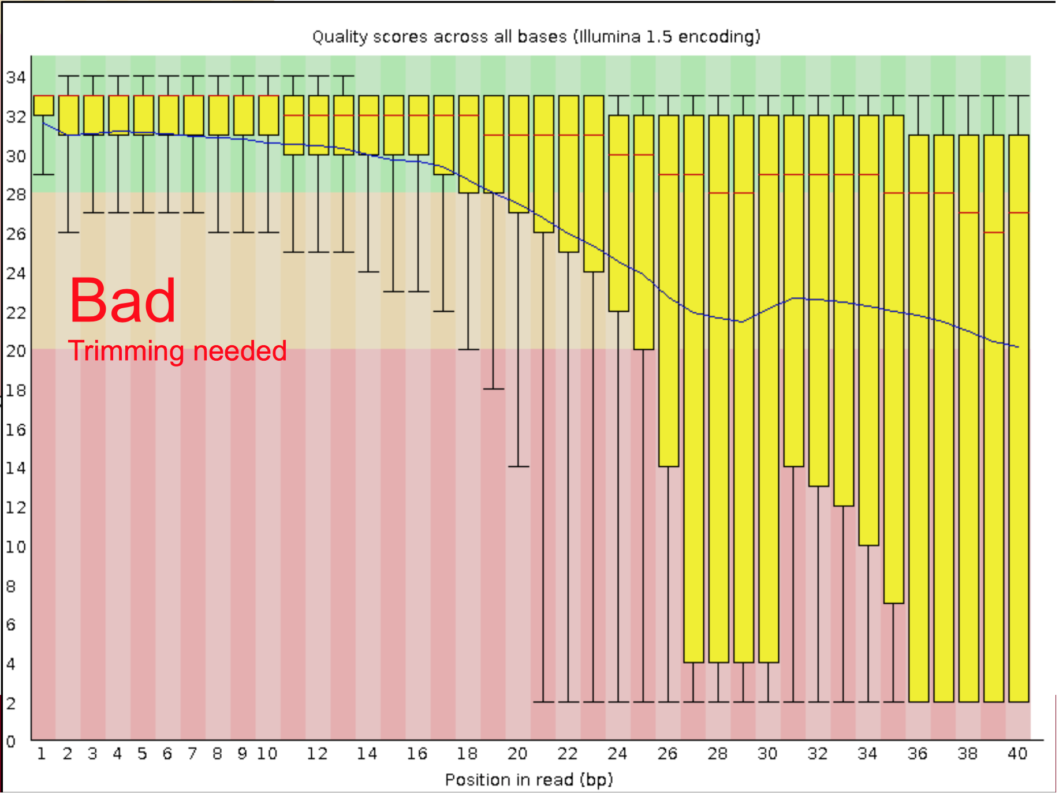
Quality control: Base quality scores

Slide 8
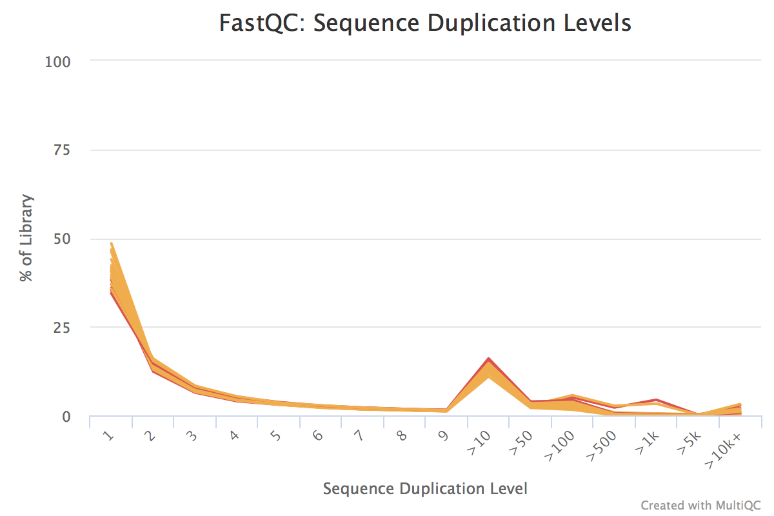
Quality Control: Sequence Duplication

Slide 9
Quality Control: Composition bias
Notes:
Bias at the ends is common. Results from biased selection of fragments (either random priming or PolyA selection). If this is the case generally recommend not trimming to correct. Most aligners now handle these issues automatically

Slide 10
Second analysis step: Transcriptome reconstruction

Slide 11
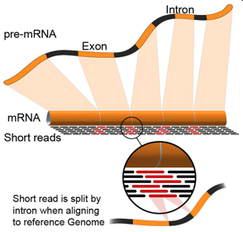
Transcriptome reconstruction
Notes:
There are 2 types of mRNA. Pre-mRNA still contains introns and mRNA has had the introns removed. Most of what is sequenced is the processed mRNA. With Next-generation sequencing the mRNA is fragmented into smaller sequences before sequencing. In order to perform differential expression analysis we need to identify from with mRNA these transcripts originated and then the gene of origin for the transcript.

Slide 12
What we will be doing:
HISAT2: Align reads to a reference genome
Cufflinks: Assemble reads into transcripts
Cuffnorm: Get normalized gene counts
featureCounts: Get raw gene counts

Slide 13
Analysis pipelines
Stark et al 2019
Notes:
This graph is missing reference free methods (Trinity)

Slide 14
Emerging methods
Single-cell analysis
Spatially resolved
Measuring active transcription
Measuring active translation

